Slide 1
Digitale Integrierte Schaltungen 2018 WS
Prof. Axel Jantsch

Slide 2
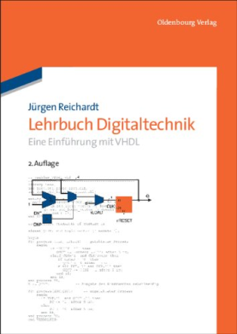
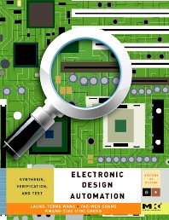
Verwendete Literatur
Lehrbuch Digitaltechnik
Jürgen Reichardt
3. Auflage, Oldenbourg 2013
https://www.degruyter.com/viewbooktoc/product/228761
Kapitel: 2,4, 7, 9, 10, 11, 12, 13, 14, 15, 16, 17
„Logic Synthesis in a Nutshell“,
Jie-Hong Jiang and Srinivas Devadas,
http://www.sciencedirect.com/science/article/pii/B9780123743640500138
Kapitel: 61, 6.2, 6.3, 6.4

Slide 3
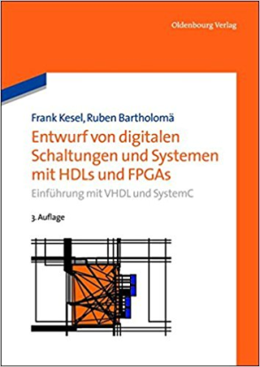

Weiterführende Literatur
Entwurf von digitalen Schaltungen und Systemen mit HDLs und FPGAs : Einführung mit VHDL und SystemC
Frank Kesel, Ruben Bartholomä
München : Oldenbourg 2013
RTL Hardware Design Using VHDL
P. Pong Chu
Wiley, 2006
http://ieeexplore.ieee.org/xpl/bkabstractplus.jsp?bkn=5237648

Slide 4
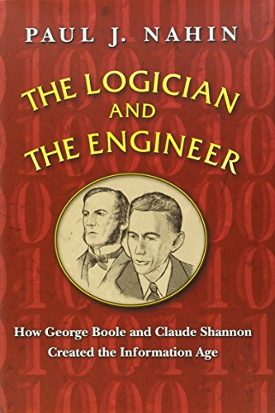
Empfohlene Lektüre für den Abend:

Slide 5
Vorspann
Was sind integrierte Schaltungen?
Was ist VLSI?
Was sind ASICs?
Was sind SoCs?

Slide 6
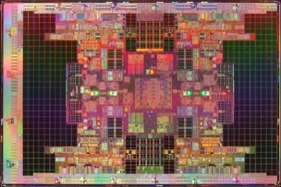
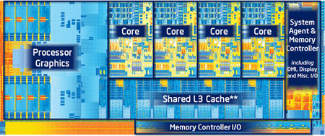
Intel Tukwila
2.046 Billion Transistors
21.5 x 32.5 mm², 65nm
170W, 2GHz
Intel Ivy Bridge
1.4 Billion Transistors
160mm², 22nm
77W, 3.9 GHz

Slide 7
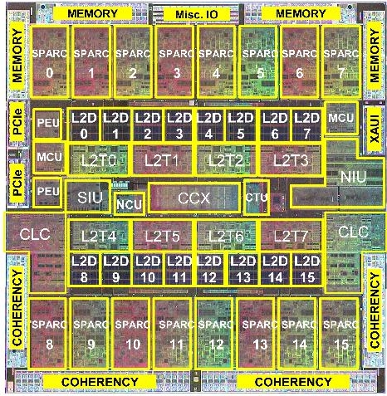
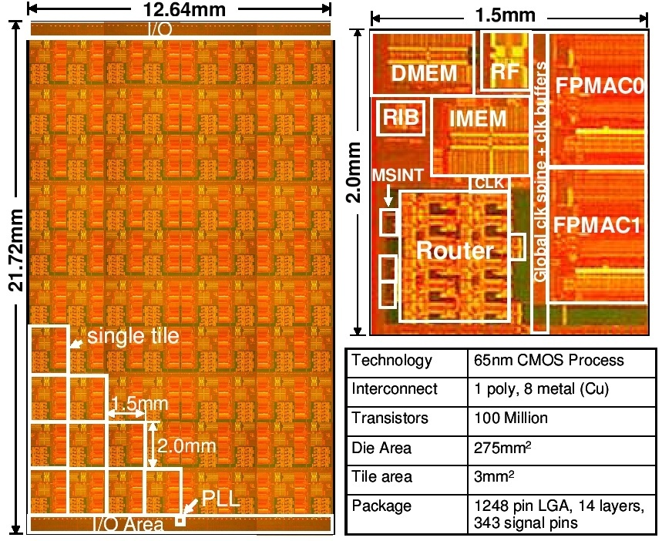
Sun Niagara 3
1 Billion Transistors
16 cores, 377mm², 40nm
1.67 GHz, 60W
Intel Teraflop
100 Million Transistors
80 cores, 275mm², 65nm
3.67GHz, 62W

Slide 8
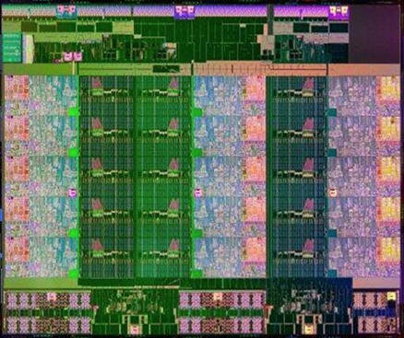
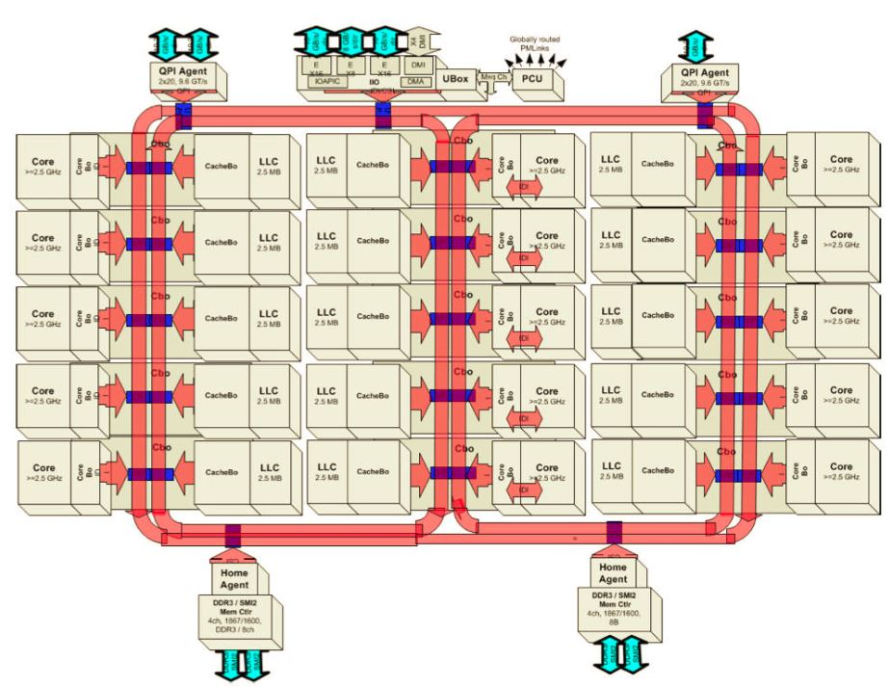
Intel Westmere Xeon E2
4.31 Billion Transistors
15 cores, 541mm², 22nm
2.8GHz, 155W

Slide 9
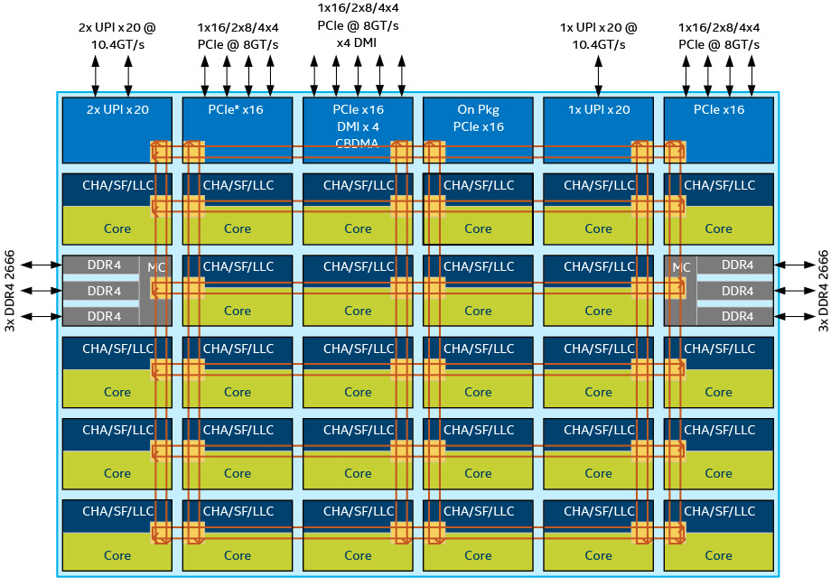
Intel Skylake Server Architecture
Notes:
https://en.wikichip.org/wiki/intel/microarchitectures/skylake_(server)
https://en.wikichip.org/wiki/intel/microarchitectures

Slide 10
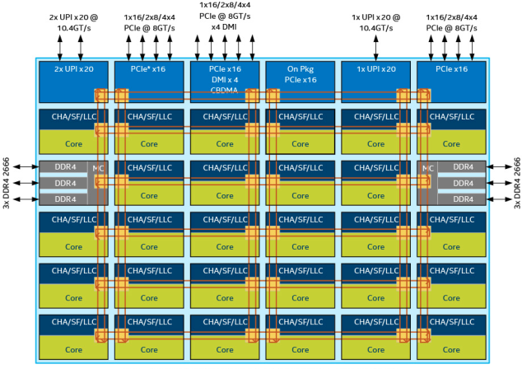
Intel Skylake Server Architecture 10-28 cores (12-30 tiles), 14nm, 694 mm2 (30 tiles)
Cache
L0 µOP cache:
1536 µOPs/core,
8-way set associative
32 sets, 6-µOP line size
L1 I Cache:
32 KiB/core,
8-way set associative
64 sets, 64 B line size
L1D Cache:
32 KiB/core,
8-way set associative
64 sets, 64 B line size
4 - 5 cycles latency
Write-back policy
L2 Cache:
1 MiB/core,
16-way set associative
64 B line size
Write-back policy
14 cycles latency
L3 Cache:
1.375 MiB/core,
11-way set associative,
shared across all cores
2,048 sets, 64 B line size
Write-back policy
50-70 cycles latency
Notes:
https://en.wikichip.org/wiki/intel/microarchitectures/skylake_(server)

Slide 11
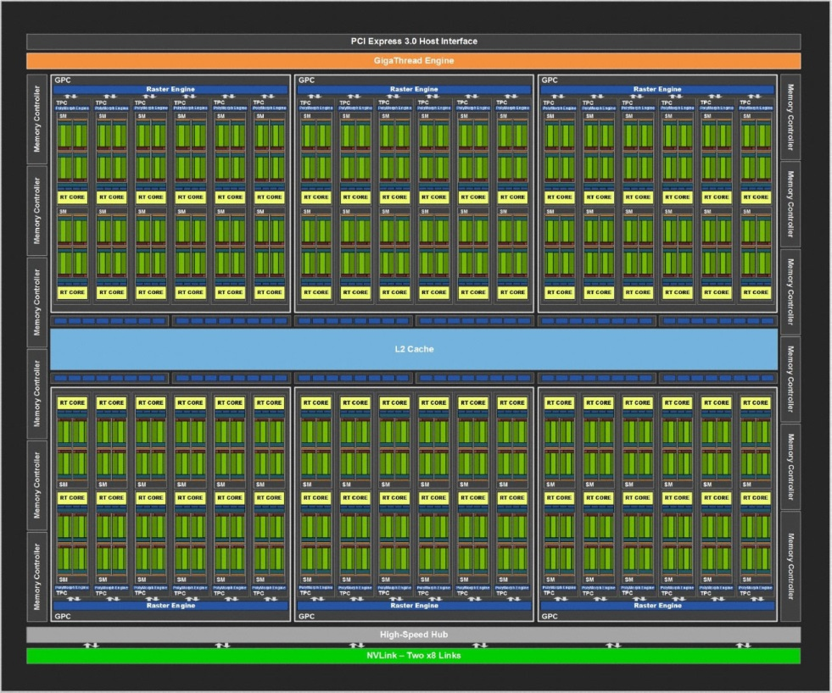
Nvidia Turin TU102
 | Full TU201
Process (nm) | 12
Transistors (billion) | 18.6
Sie size (mm²) | 754
Streaming Multiprocessors (SM) | 72
CUDA Cores | 4608 (64/SM)
Tensor Cores | 576 (8/SM)
RT Cores | 72
Clock (MHz) | ≤ 1500
CUDA TFlops (FP32) | 13.8
L1 Cache (MB) | 6.912
L2 Cache (MB) | 6
Bus width | 384
Power (W) | 200-250
Bandwidth (GB/s) | 672
Notes:
Very good description of the Nvidia Turing architecture: https://www.pcgamer.com/nvidia-turing-architecture-deep-dive/
Performance table for Nvidia processors: https://cdn.mos.cms.futurecdn.net/mTXY8cGt2ooCjqMFb7ssKQ.png

Slide 12
Nvidia Turin TU102
Notes:
Very good description of the Nvidia Turing architecture: https://www.pcgamer.com/nvidia-turing-architecture-deep-dive/
Performance table for Nvidia processors: https://cdn.mos.cms.futurecdn.net/mTXY8cGt2ooCjqMFb7ssKQ.png

Slide 13
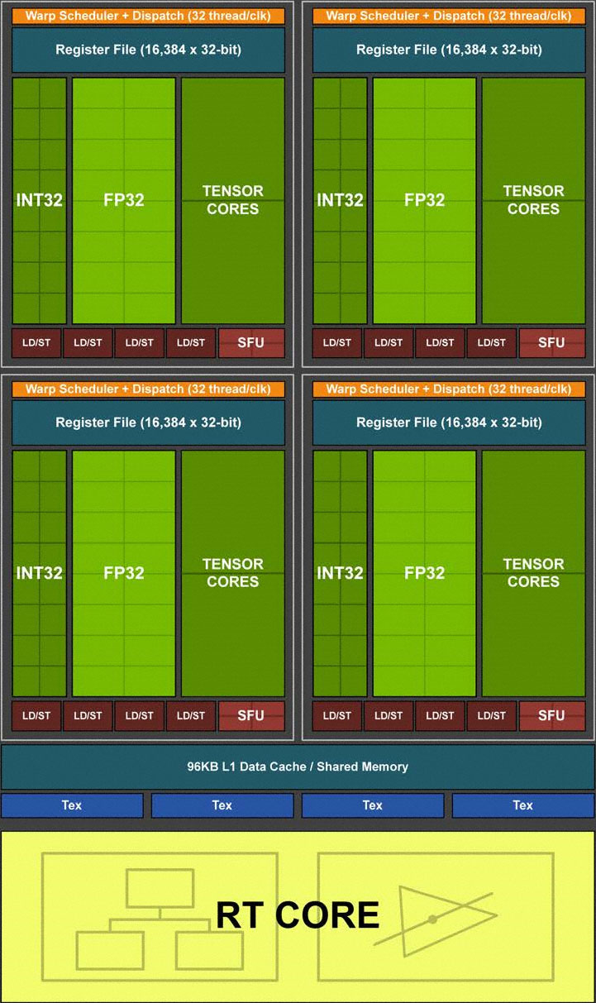
Nvidia Turin TU102 Streaming Multiprocessor
Notes:
Very good description of the Nvidia Turing architecture: https://www.pcgamer.com/nvidia-turing-architecture-deep-dive/
Performance table for Nvidia processors: https://cdn.mos.cms.futurecdn.net/mTXY8cGt2ooCjqMFb7ssKQ.png

Slide 14
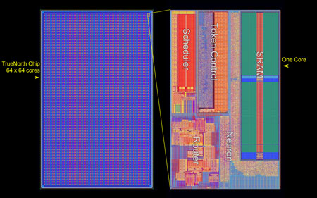
IBM TrueNorth
5.4 Billion Transistors
4096 cores, 350mm², 28nm
70mW

Slide 15
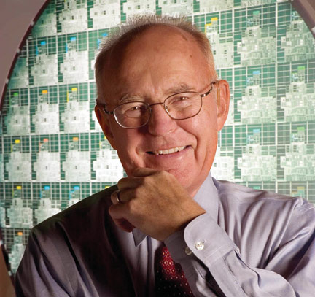

1965
born 1929
Gordon E. Moore, "Cramming More Components onto Integrated Circuits", Electronics, pp. 114-117, April 1965.

Slide 16
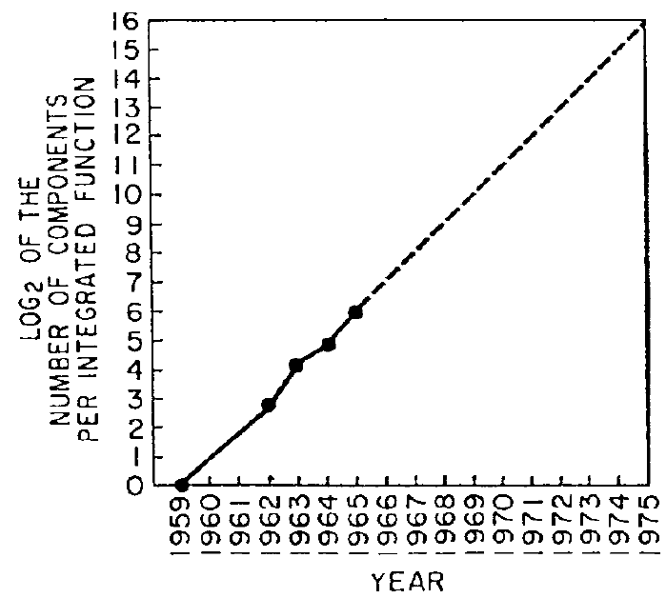
Moore‘s Law
Gordon E. Moore, "Cramming More Components onto Integrated Circuits", Electronics, pp. 114-117, April 1965.

Slide 17
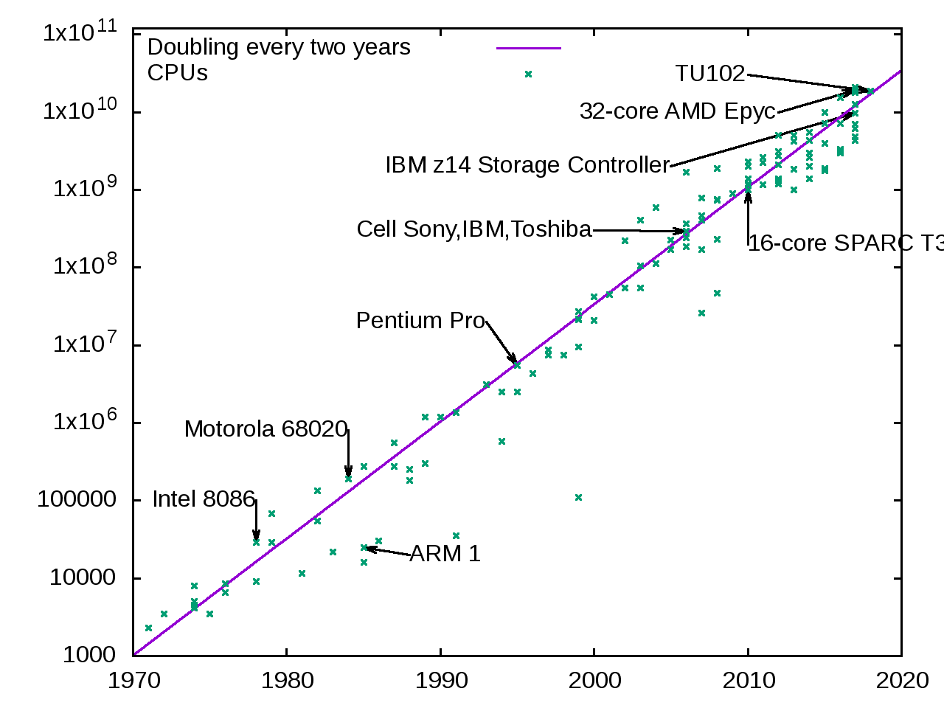
CPUs Transistor Count

Slide 18
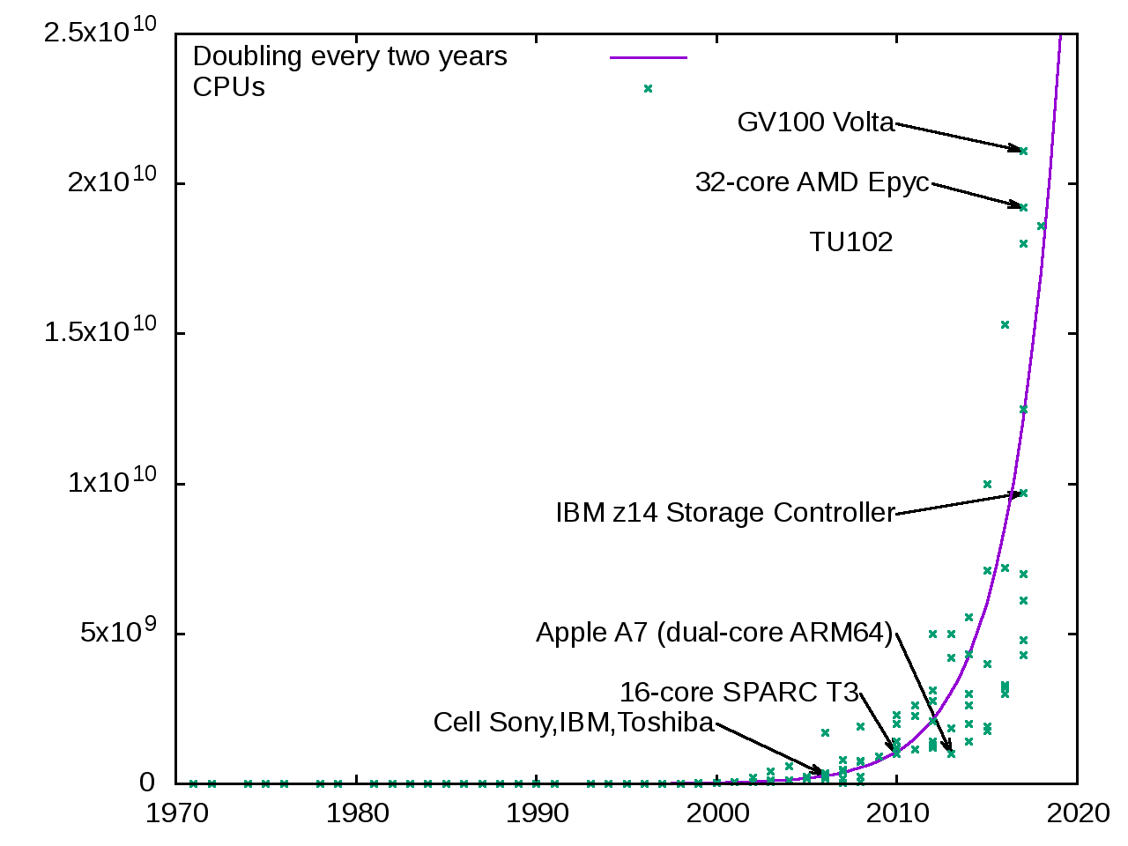
CPUs Transistor Count

Slide 19
Three Main Deflection Points
Mead-Conway Revolution in 1980
Systems-on-Chip in 2000
Multi-Core Revolution in 2010

Slide 20
1980 20 000 Transistoren

Slide 21
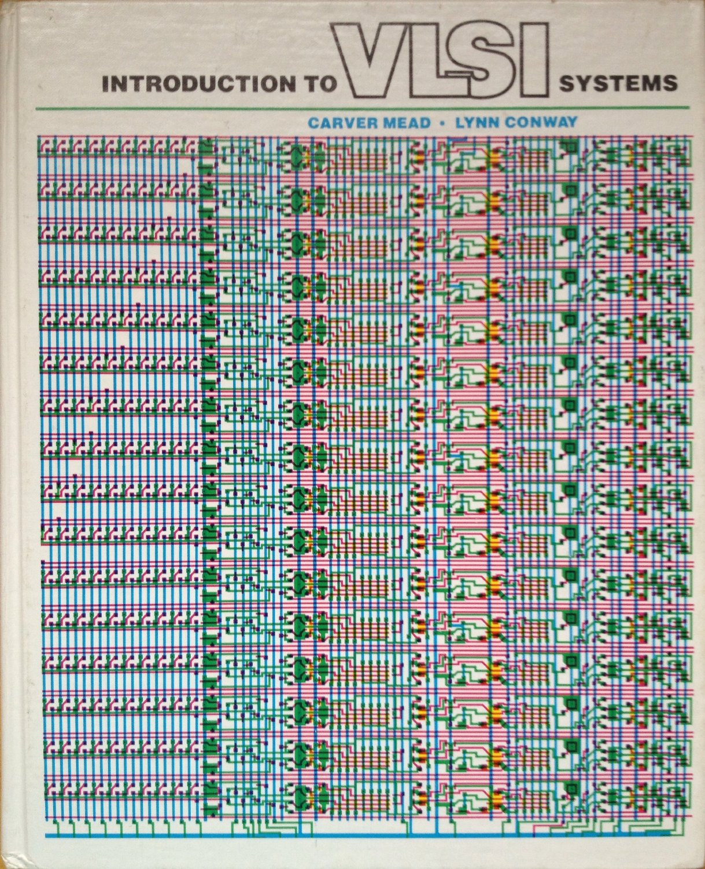
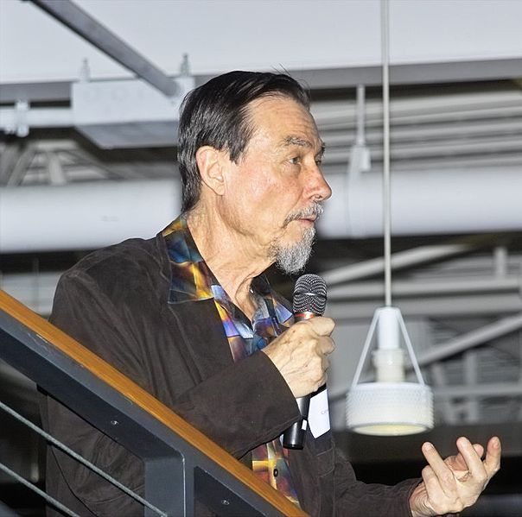

Mead-Conway Revolution
born 1934
born 1938
Carver Mead and Lynn Conway, Introduction to VLSI Systems, Addison-Wesley, 1980.
1980 – 20 000 Transistors

Slide 22
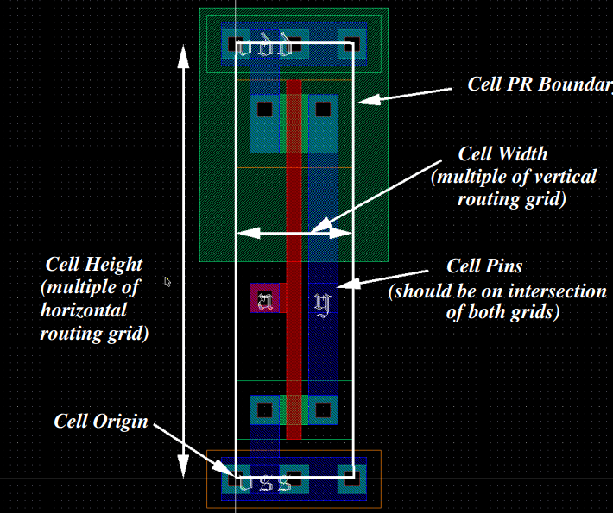
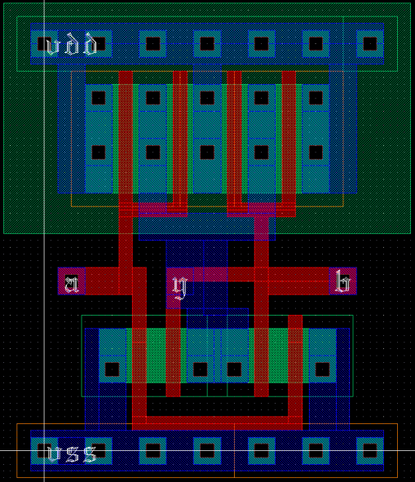
Standard Cells

Slide 23
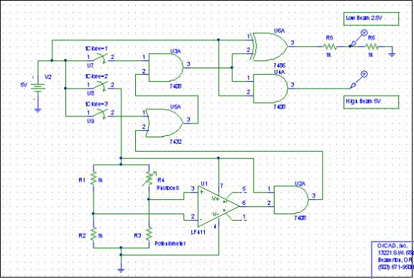
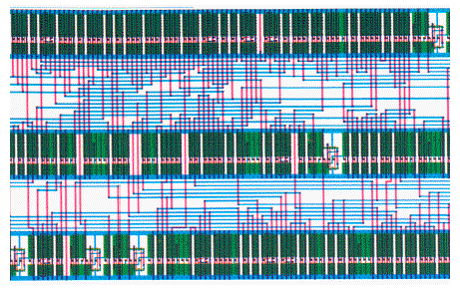
Standard Cells

Slide 24
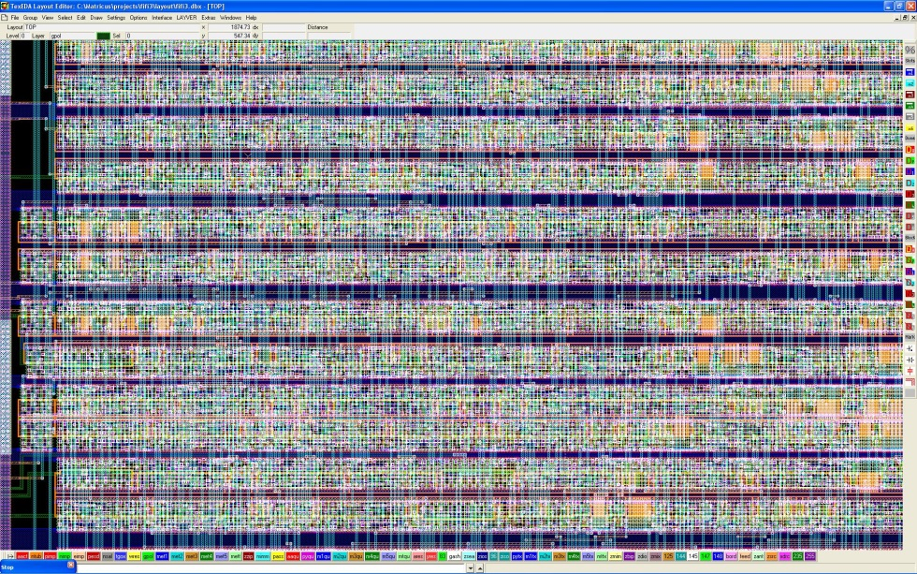
Standard Cells

Slide 25
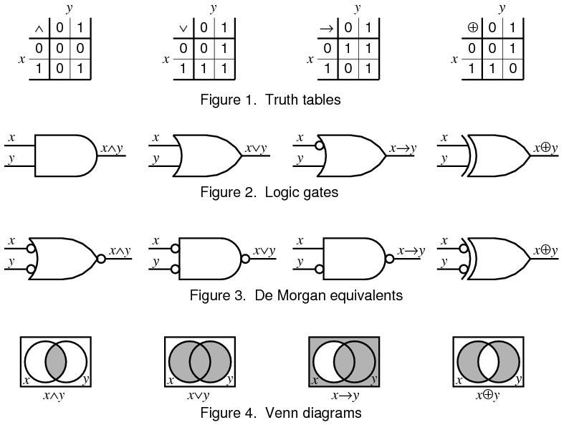
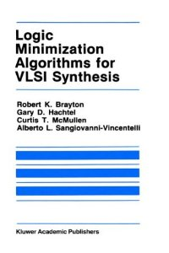
Logic Synthesis
Logic Minimization Algorithms for VLSI Synthesis, Kluver Academic Publisher, Robert K. Brayton, Gary D. Hachtel, Curtis T. McMullen, and Alberto L. Sangiovanni-Vincentelli, 1984.

Slide 26
1990 1 000 000 Transistoren

Slide 27
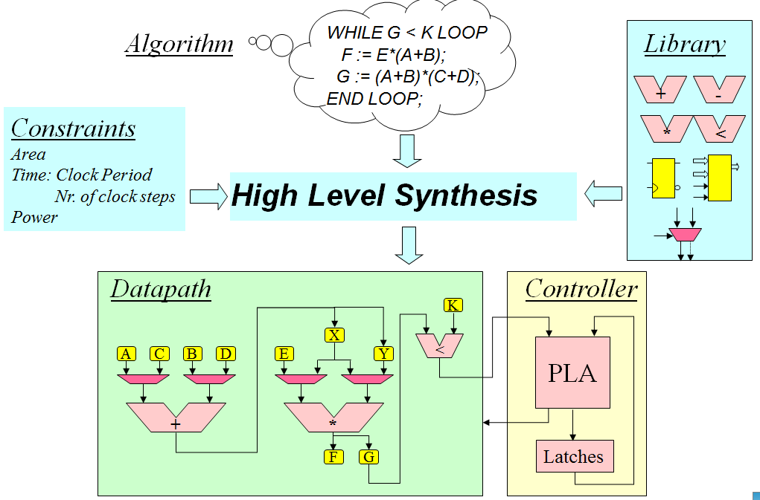
High Level Synthesis
1990 – 1 000 000 Transistors

Slide 28
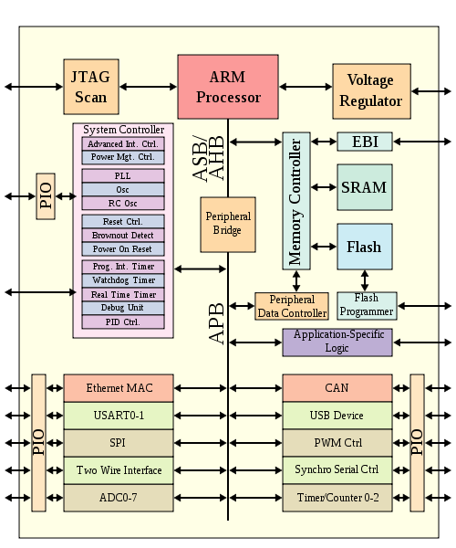
Emergence of Systems on Chip

Slide 29
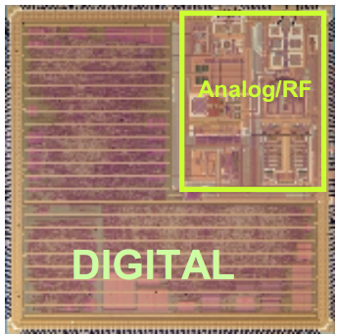
Emergence of Systems on Chip

Slide 30
2000 20 000 000 Transistoren

Slide 31
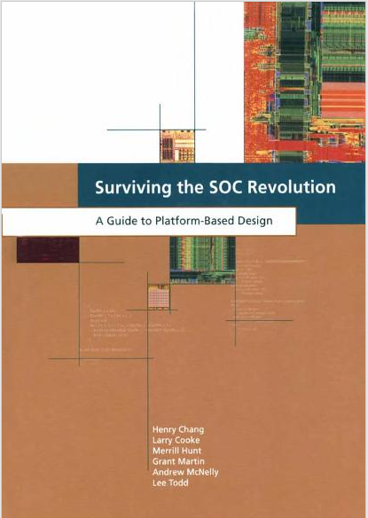
The SoC Revolution
Surviving the SOC Revolution - A Guide to Platform-Based Design, Kluwer Academic Publishers, Henry Chang, Larry Cooke, Merrill Hunt, Grant Martin, Andrew McNelly, and Lee Todd, 1999.
2000 – 20 000 000 Transistors

Slide 32
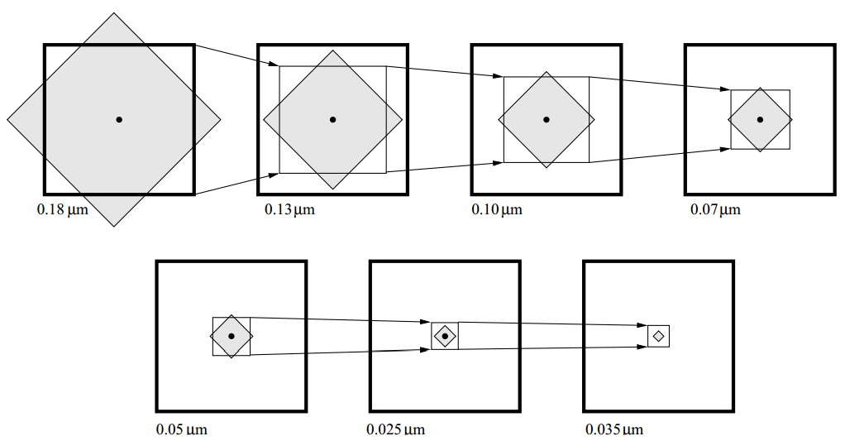
Wires Don‘t Scale
Chip size
Reachable
area per
Clock cycle
------------
0.035 µm
------------
0.025 µm
Ron Ho, On-chip wires: Scaling and efficiency, PhD thesis, Stanford University, 2003.
Notes:
This assumes that clock frequency scales with transistor delay, which in fact did not happen.

Slide 33
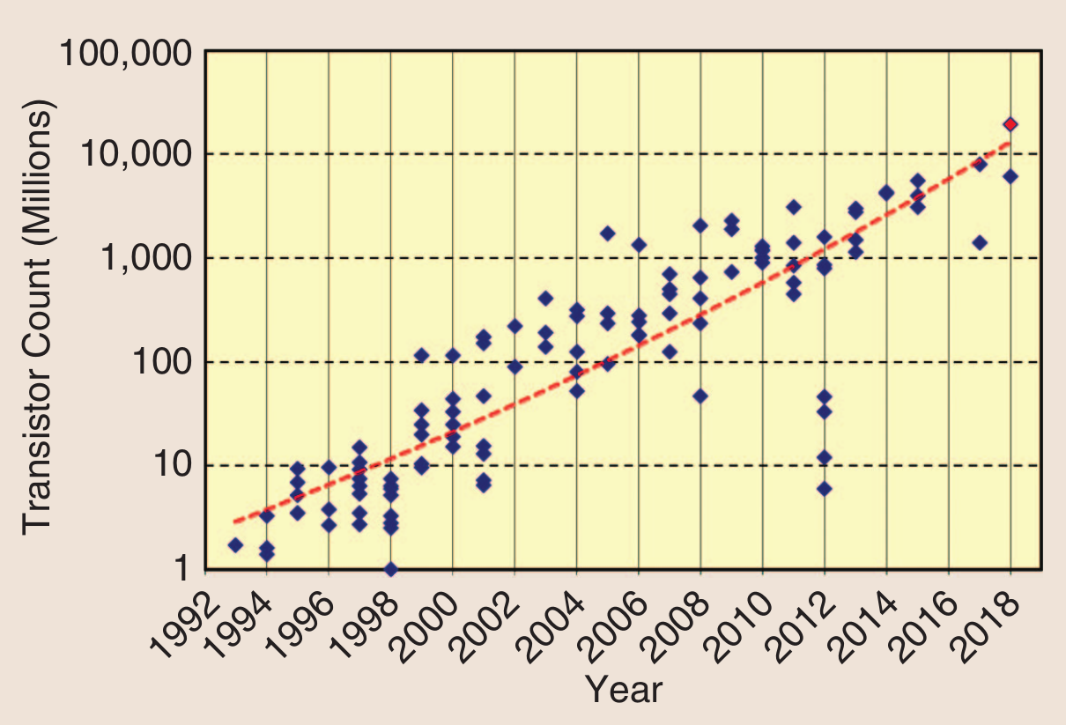
Capacity Trend
From ISSCC 2018 Technology Trends
Notes:
The red dot is a Multi-Chip-Module

Slide 34
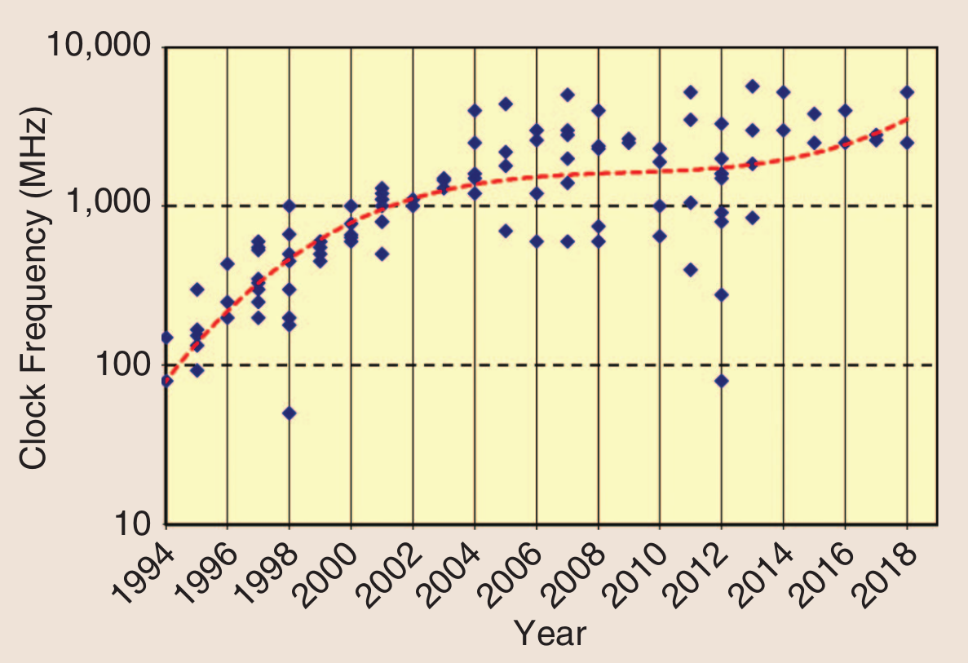
End of Frequency Scaling
From ISSCC 2018 Technology Trends

Slide 35
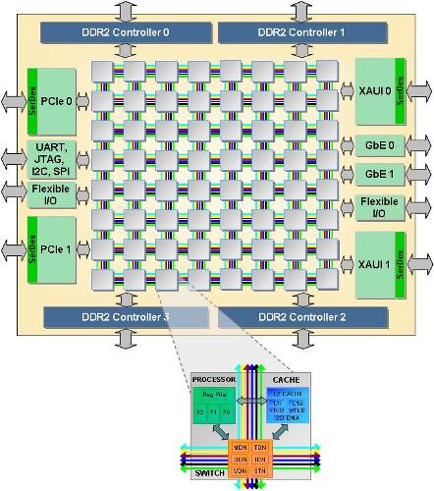
Emergence of Networks-on-Chip
Intel Teraflop
Tilera TilePro 64

Slide 36
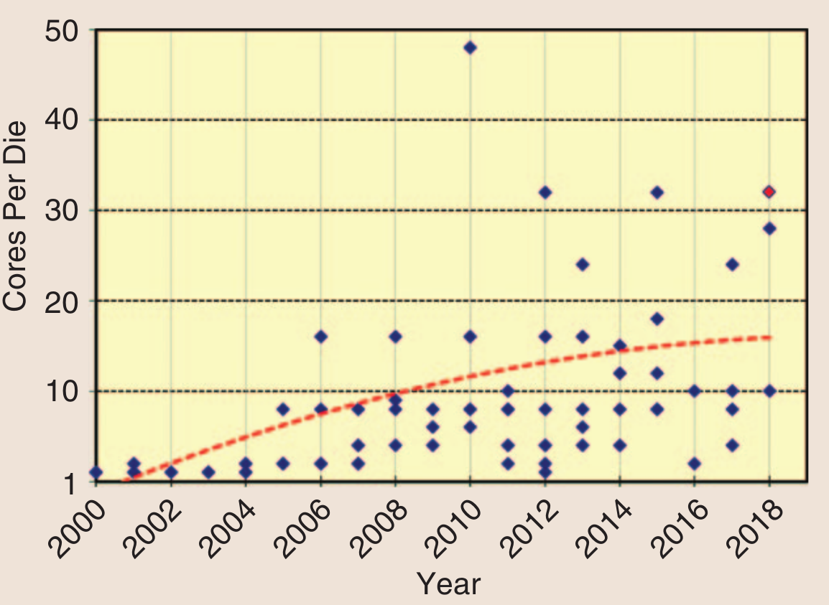
The Multicore Revolution - Core Count
From ISSCC 2018 Technology Trends
Notes:
The red dot is a Multi-Chip-Module

Slide 37
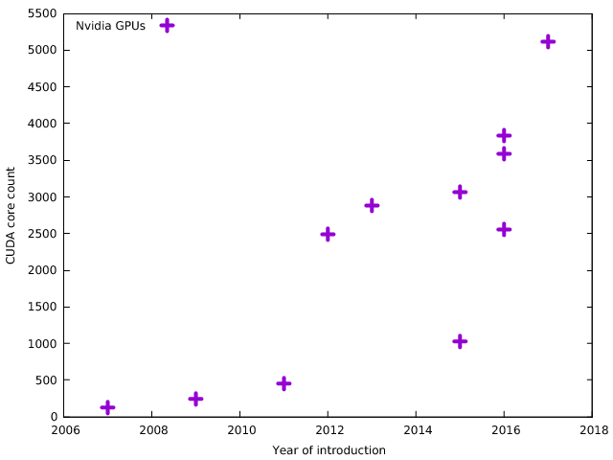
Graphics Processors

Slide 38
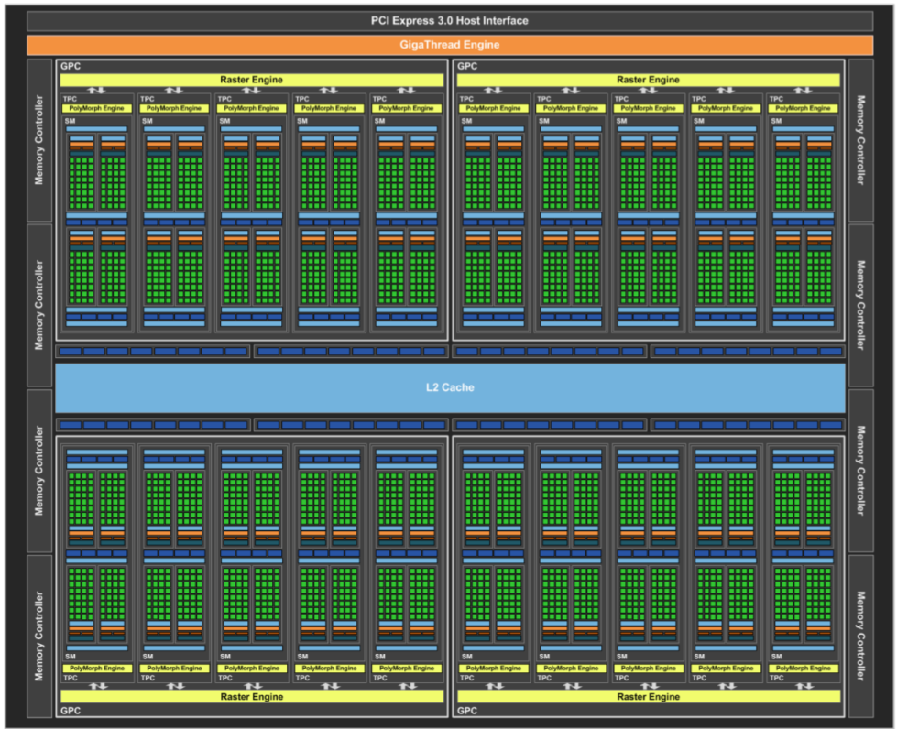
The Multicore Revolution
Notes:
Nvidia GP104 GPU with 2560 cores

Slide 39
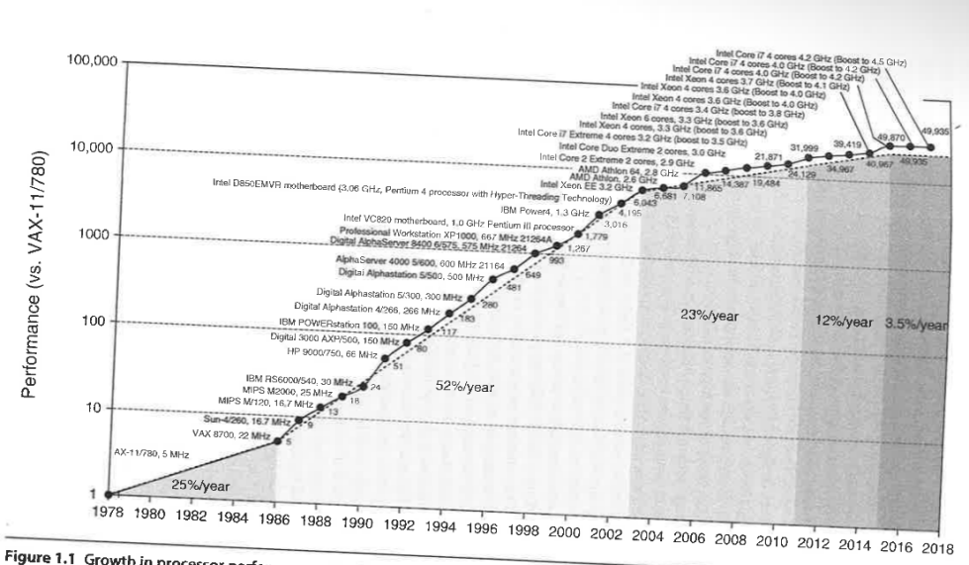
Performance Growth
Performance as measured by the SPEC INT Benchmark
Computer Architecture, J. Hennessy and D. Patterson, 6th edition, 2018; Figure 1.1 page 3.
Notes:
As measured by the SPEC INT Benchmark

Slide 40
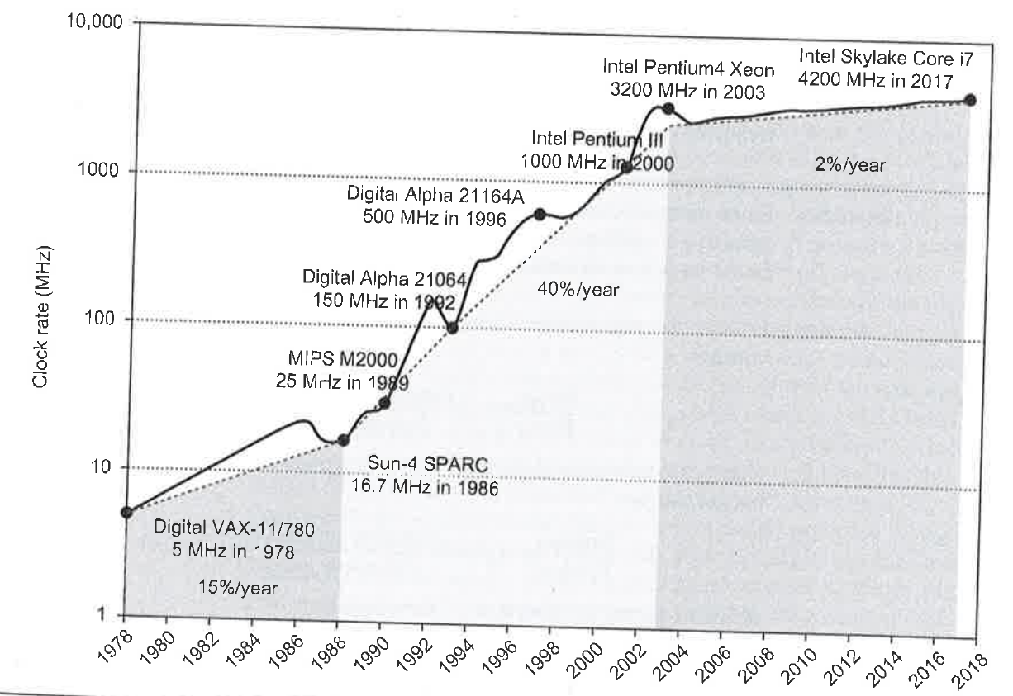
Clock Frequency Growth
Computer Architecture, J. Hennessy and D. Patterson, 6th edition, 2018; Figure 1.11 page 26.

Slide 41
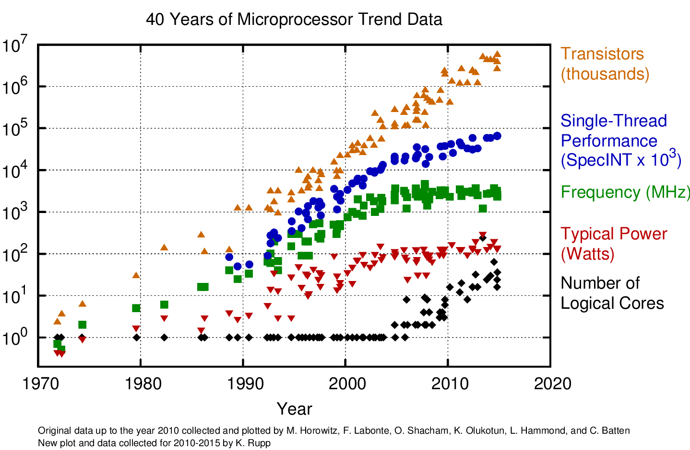
Notes:
https://www.karlrupp.net/2015/06/40-years-of-microprocessor-trend-data/

Slide 42
Technology Roadmap
Technology node (2-3 Years) scaling -2030:
Performance: >30% more maximum operating frequency at constant energy
Power: >50% less energy per switching at a given performance
Area: >50% area reduction
Cost: <30% wafer cost – 30-35% less die cost for scaled die.
International Roadmap for Devices and Systems
2016 Edition
More Moore White Paper
https://irds.ieee.org

Slide 43
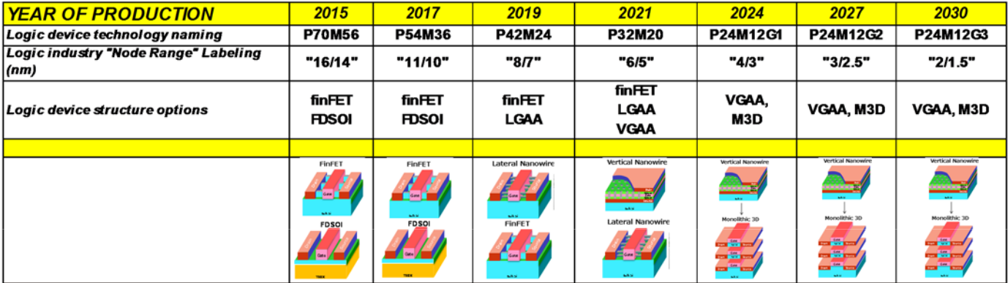
Technology Roadmap
PxxMxx notation refers to Pxx: contacted poly pitch and Mxx: metalx pitch in nm.
Acronyms used:
FDSOI: Fully-Depleted Silicon-On-Insulator (FDSOI),
LGAA: Lateral Gate-All-Around-Device (GAA),
VGAA: Vertical GAA,
M3D: Monolithic-3D.
International Roadmap for Devices and Systems, 2016 Edition
More Moore White Paper, https://irds.ieee.org
Notes:
PxxMxx notation refers to Pxx: contacted poly pitch and Mxx: metalx pitch in nm.
Acronyms used in the table (in order of appearance): FDSOI: Fully-Depleted Silicon-On-Insulator (FDSOI),
LGAA: Lateral Gate-All-Around-Device (GAA), VGAA: Vertical GAA, M3D: Monolithic-3D.
LGAA means that source and drain are beside each other and the channels go horizontally between them;
VGAA means that source and drain are stacked on top of each other and the channels go vertically between them.

Slide 44
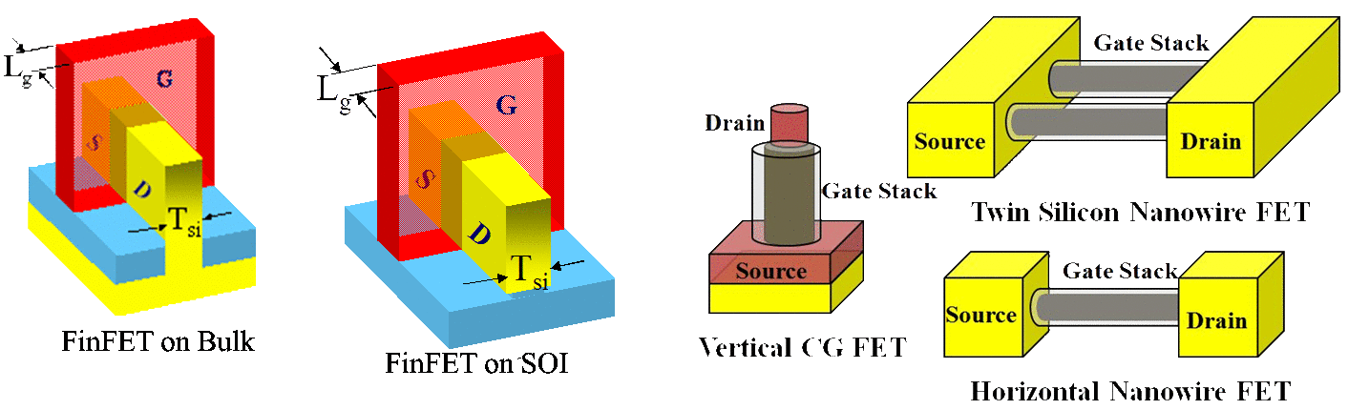
FinFET und Gate All Around
By Navid.paydavosi - CC BY-SA 3.0, https://commons.wikimedia.org/w/index.php?curid=18843888

Slide 45
Technology Roadmap
 | 2015 | 2017 | 2019 | 2021 | 2024 | 2027 | 2030
Industry labeling | „16/14“ | „11/10“ | „8/7“ | „6/5“ | „4/3“ | „3/2.5“ | „2/1.5“
Metal pitch (nm) | 56 | 36 | 24 | 20 | 12 | 12 | 12
Contacted Poly pitch (nm) | 70 | 48 | 42 | 32 | 24 | 24 | 24
L_{g}: HP Logic (nm) | 24 | 18 | 14 | 10 | 10 | 10 | 10
L_{g}: LP Logc (nm) | 26 | 20 | 16 | 12 | 12 | 12 | 12
Vdd (V) | 0.8 | 0.75 | 0.7 | 0.65 | 0.55 | 0.45 | 0.4
V_{t} : HP (V) | 0.129 | 0.129 | 0.133 | 0.136 | 0.084 | 0.052 | 0.052
V_{t} : LP (V) | 0.351 | 0.336 | 0.333 | 0.326 | 0.201 | 0.125 | 0.125
Inversion layer thickness (nm) | 1.1 | 1.0 | 0.9 | 0.85 | 0.8 | 0.8 | 0.8
Energy/switching (fJ) | 3.47 | 2.52 | 1.89 | 1.24 | 0.94 | 0.63 | 0.50
International Roadmap for Devices and Systems, 2016 Edition
More Moore White Paper, https://irds.ieee.org
Notes:
For comparison, size of silicon atom:
The bond length in SiSi is: 235.2pm = 0.2352nm
Atomic radius ~ 0.11 nm
van der Waals radius ~ 0.219 nm (Radius of atoms in non-bonding atoms)
From: https://www.webelements.com/silicon/atom_sizes.html

Slide 46
Technology Roadmap
 | 2015 | 2017 | 2019 | 2021 | 2024 | 2027 | 2030
Industry labeling | „16/14“ | „11/10“ | „8/7“ | „6/5“ | „4/3“ | „3/2.5“ | „2/1.5“
SRAM density (Mbit/mm2) | 17 | 29 | 50 | 78 | 217 | 217 | 217
NAND2 density (Mgates/mm2) | 9 | 19 | 33 | 78 | 87 | 87 | 87
FO3 delay(ps) | 14.80 | 11.28 | 11.03 | 8.69 | 9.43 | 8.67 | 8.33
FO3 dynamic power @1GHz (μW) | 3.49 | 1.93 | 1.07 | 0.56 | 0.3 | 0.2 | 0.16
FO3 leakage power (μW) | 0.118 | 0.081 | 0.048 | 0.029 | 0.017 | 0.014 | 0.012
No of wiring layers | 13 | 14 | 15 | 16 | 18 | 22 | 30
International Roadmap for Devices and Systems, 2016 Edition
More Moore White Paper, https://irds.ieee.org

Slide 47
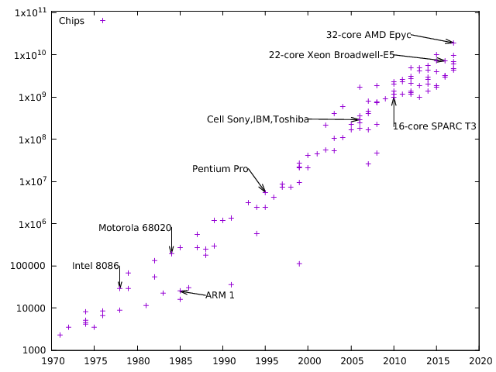
Moore‘s Law worked from 1962-2018.
When will it end ?

Slide 48
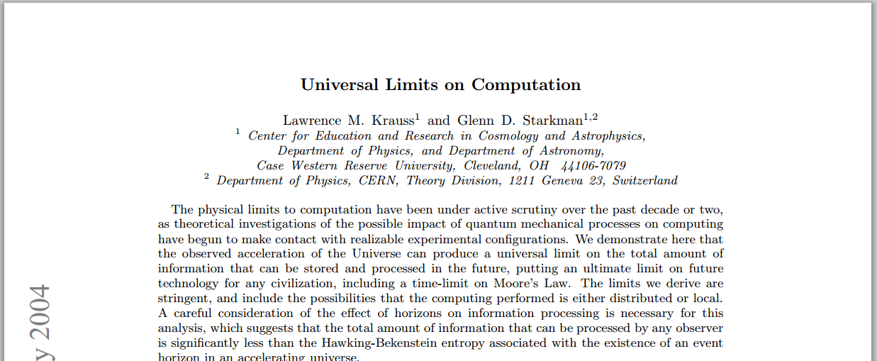
In 2604

